Slide 1
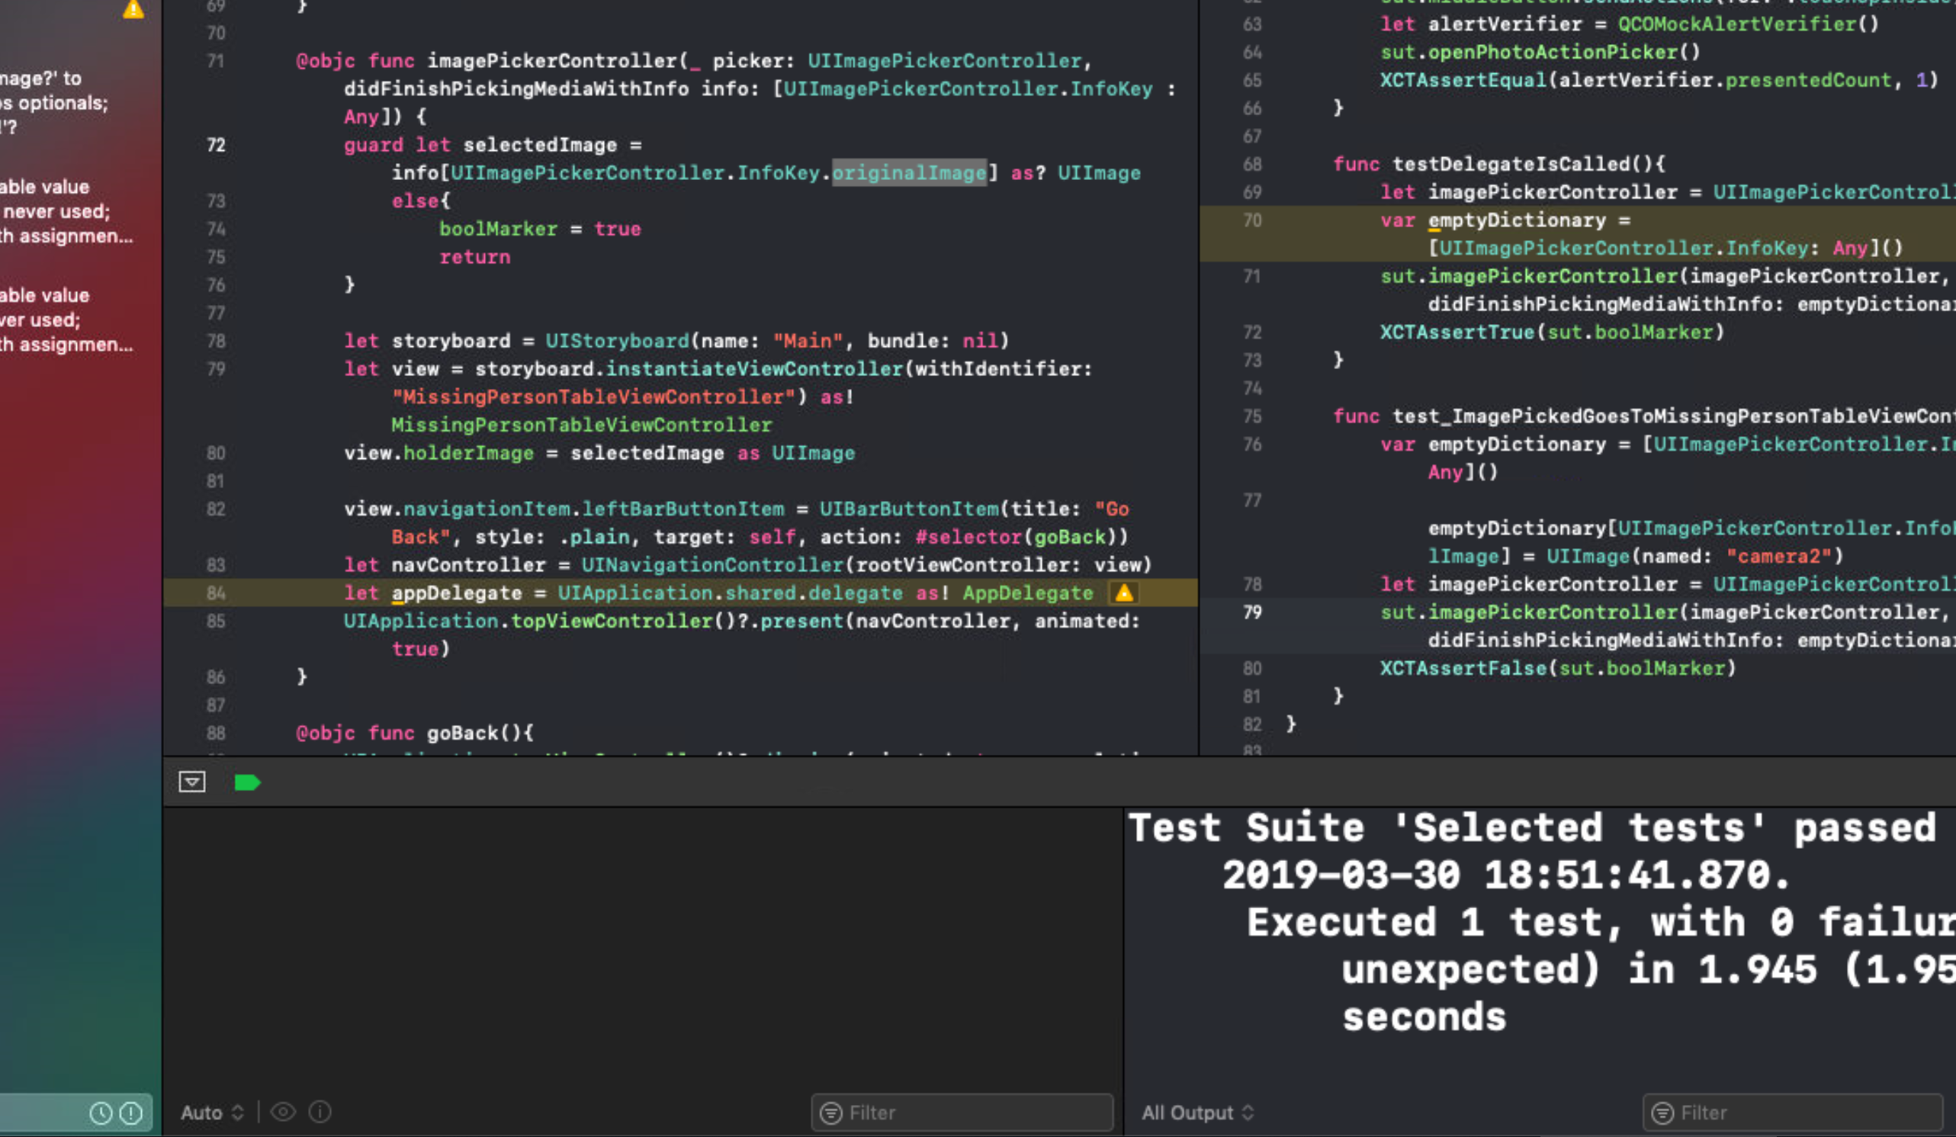
Edward – Week 9 (1) Completed Tasks
This past week, I was able to attain 90+% coverage for all S3-related code.
I also finished cleaning up a majority of the code, moving and breaking functions apart to allow for easier testing, and removing unnecessary print and commented statements.

Slide 2
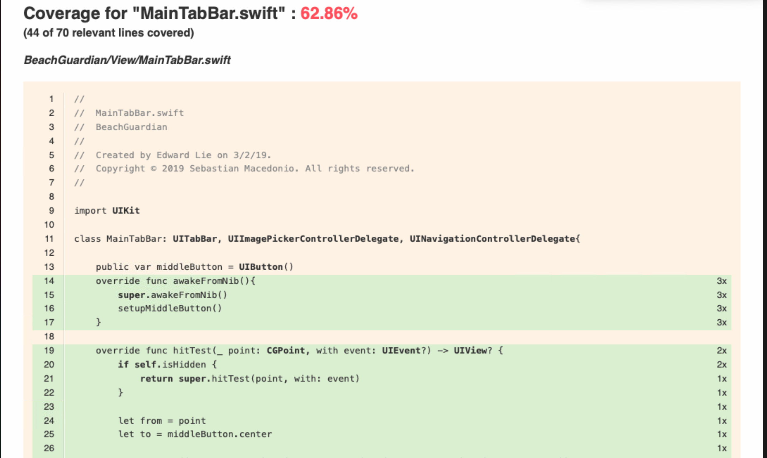
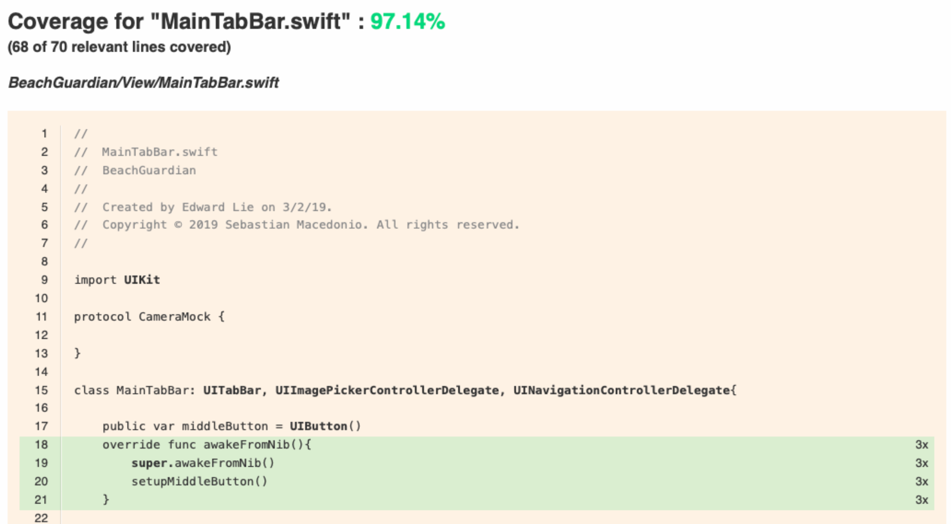
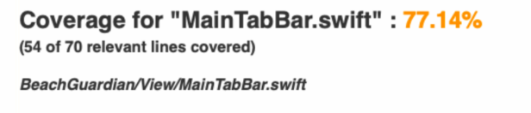
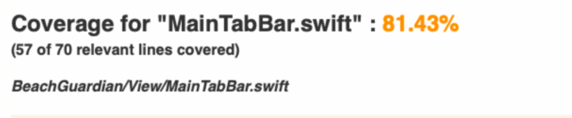
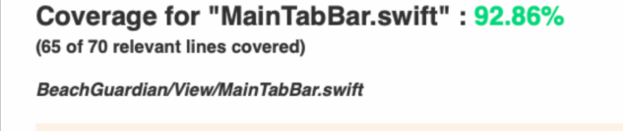
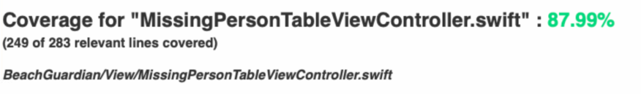
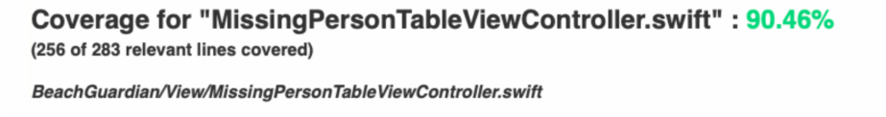
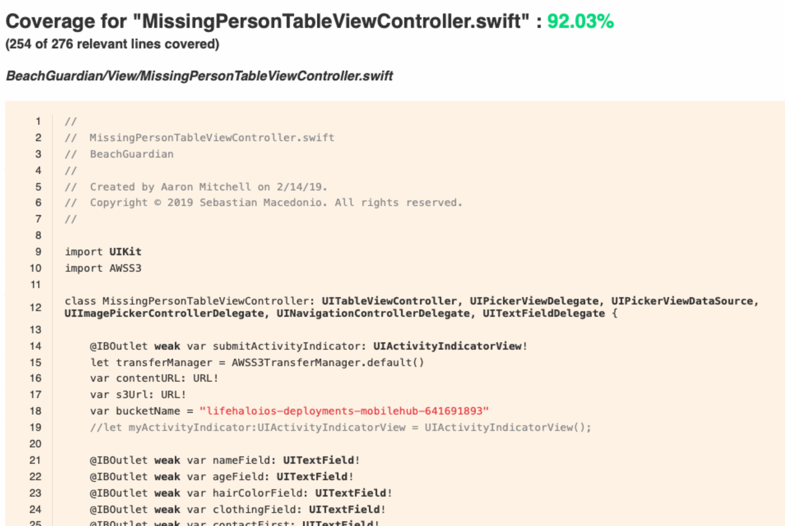
Edward – Week 9 (2) Completed Tasks
Committing more frequently to repository
More tests passing for main tab bar
More tests passing for S3 in missing person table view controller

Slide 3
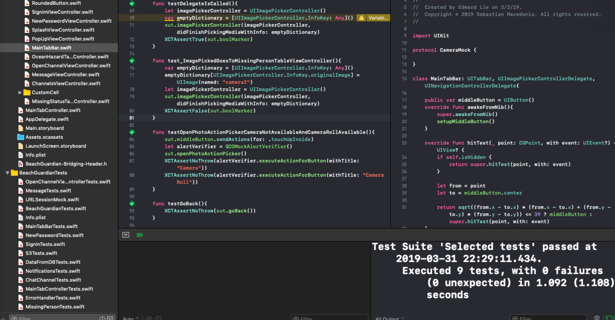
Edward Lie – Week 9 (3) In Progress Tasks
My week 10 goal is to move into the remaining parts of the program that need S3 and mock the parts of the program that need mocking.

